Slide 1
Capstone Project
Football Data analysis
K. Haripriya Sudheera
EN12025082772
DA364S36

Slide 2
Introduction:
Football Data Analysis: Uncovering Success Factors in the Game
Football, a globally celebrated and dynamic sport, is influenced by a multitude of
factors that shape the outcomes of matches and the success of teams and players.
Harnessing the power of data analysis, this project aims to explore key areas such as Performance Analysis, Player Profile and Market Value, Team Comparison, Attendance and Stadium Analysis, Referee Analysis, Substitution Patterns, Event Analysis, Competition Analysis, Player Attributes and Demographics, Contract Management.
Through the analysis of large football datasets, we seek to extract meaningful insights to
inform decision-making for coaches, scouts, and analysts.
This involves a systematic approach to data collection, preprocessing, and exploration using tools like Python, MySQL, Tableau, and Excel.
The project will leverage techniques such as Exploratory Data Analysis (EDA),
descriptive analysis, and predictive modeling to uncover patterns and correlations.

Slide 3
Approach:
The project involves:
Data Preprocessing & Integration
Merging and cleaning multiple data files for comprehensive analysis.
Exploratory Data Analysis (EDA):
Understanding trends and patterns.
Descriptive Analysis & Predictions:
Leveraging machine learning models and statistical methods.
Visualization & Insights Generation:
Using tools like Python, MySQL, Excel, and Tableau to visualize and present findings.

Slide 4
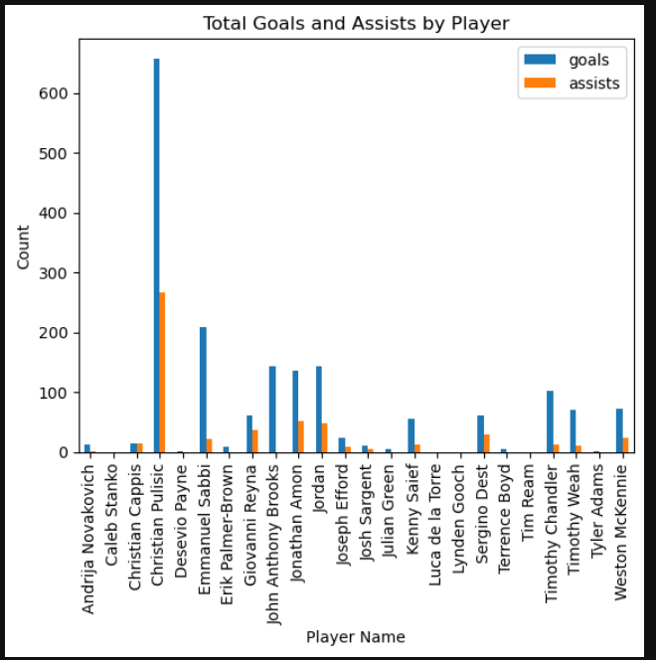
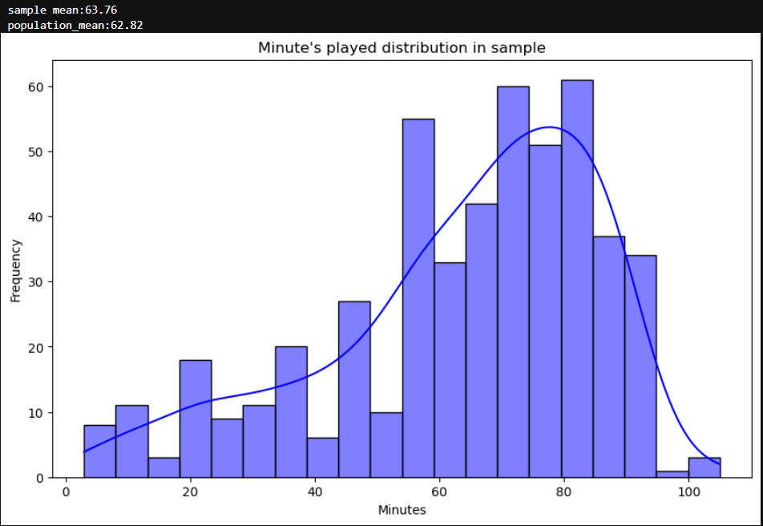
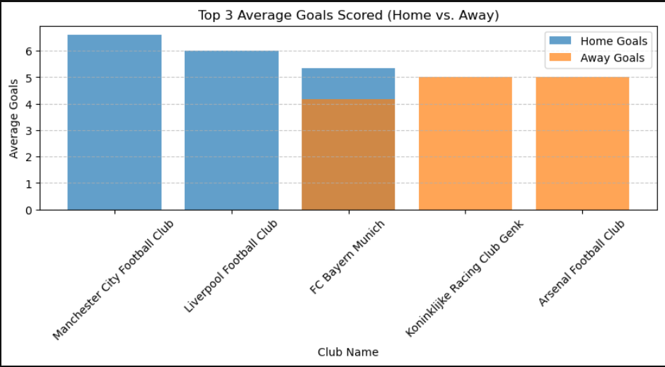
Performance analysis:
Interpretation:
1. The Central Limit Theorem (CLT) applies here as the histogram of the sample data appears approximately normal, especially with a sufficiently large sample size. The sample mean (63.76) is close to the population mean (62.82), supporting the CLT's rule that the sample mean approximates the population mean for large samples. Additionally, the distribution’s shape supports that the sampling distribution of the mean becomes normal regardless of the population's distribution.
2. Christian Pulisic scored more goals and given more assists.
3. The top 3 clubs scoring average goals in the home are Manchester City Football club, Liver pool Football Club and FC Bayern Munich. The top 3 clubs scoring average goals from away are FC Bayern Munich, Koninklijike Racking club genk and arsenal Football club

Slide 5
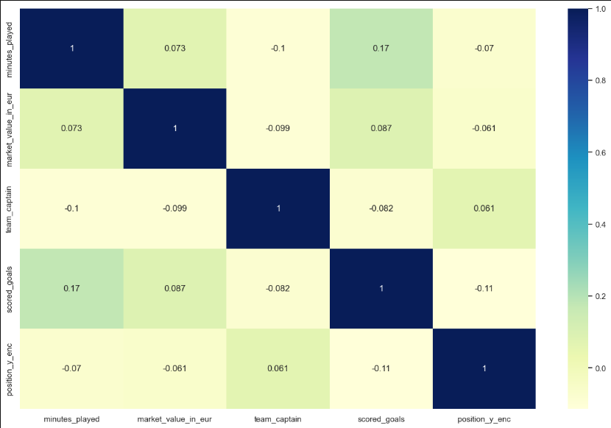
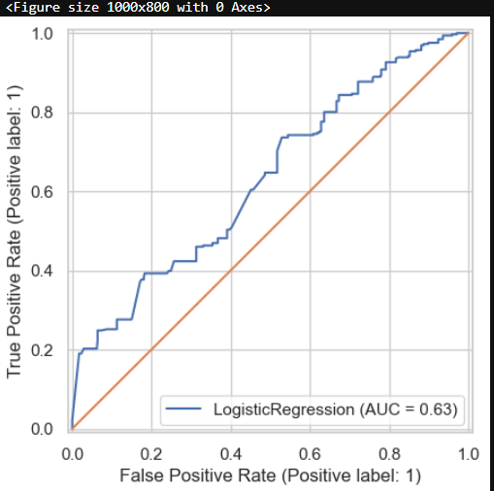
Performance analysis:
Interpretation:
1. Position_x_enc and Market Value: There's a moderate positive correlation (0.31) between the encoded position and market value. This suggests that players in certain positions (likely attacking positions) tend to have higher market values. Negative Correlations: Position_x_enc and Scored Goals: There's a weak negative correlation (-0.14) between the encoded position and goals scored. This might indicate that players in certain defensive positions, which are often encoded with low.
2. The ROC curve visualizes the trade-off between true positive rate (sensitivity) and false positive rate (specificity) for different classification thresholds. The AUC (Area Under the Curve) of 0.63 indicates moderate discriminative power. A higher AUC closer to 1 signifies better model performance in distinguishing between positive and negative classes.

Slide 6
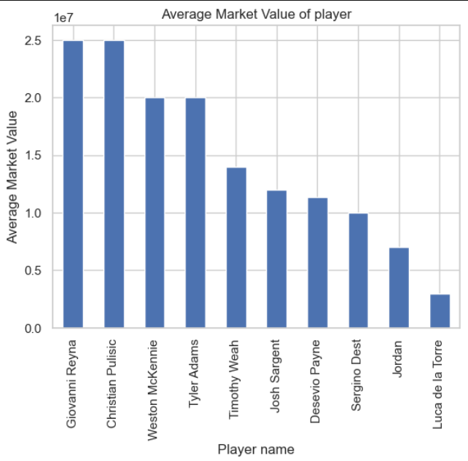
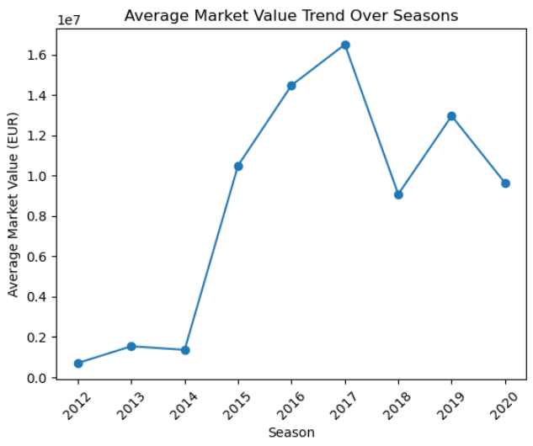
2. Player Profile and Market Value :
Interpretation:
1.Giovanni Reyna has the highest market value.
2. 2017 has the highest average market value.

Slide 7
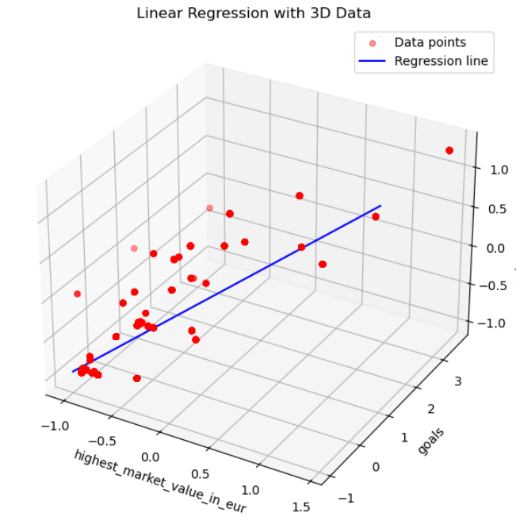
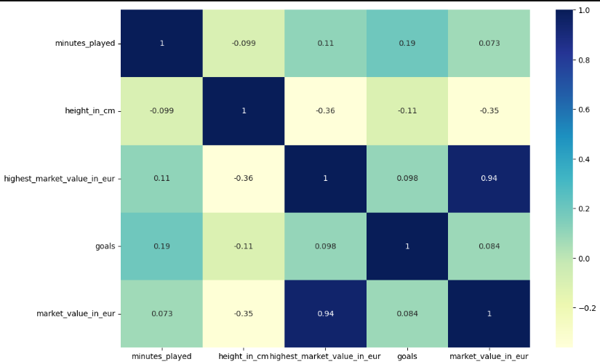
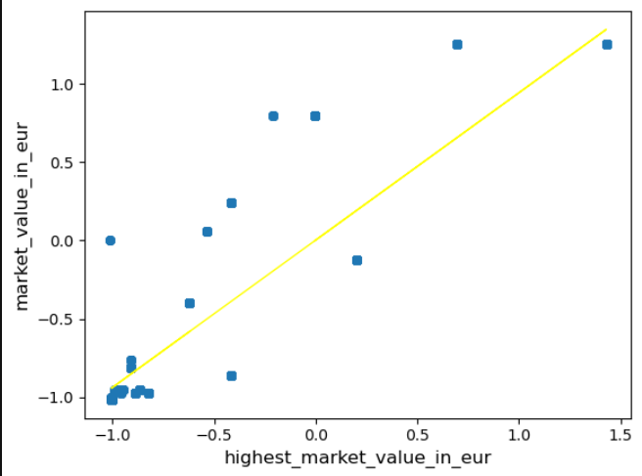
Player Profile and Market Value :
Interpretation:
Strong Performance: Low Errors: MSE (0.1105): A very low MSE indicates that the model's predictions are generally close to the actual values. MAE (0.2328): A low MAE suggests that the average absolute difference between predictions and actual values is small, indicating high accuracy. RMSE (0.3324): A low RMSE suggests that the average magnitude of the errors is relatively small.
High R-squared: R-squared (0.8902): A high R-squared value indicates that the model explains a substantial portion (89.02%) of the variability in the target variable. This suggests a strong linear relationship between the predictor and the target.
Over all: The model demonstrates strong performance in predicting the target variable. The low error values and high R-squared value suggest that the model is accurate and provides a good fit to the data. This indicates that the predictor variable is a significant factor in explaining the variability of the target variable.The scatter plot visualizes a positive linear relationship between the highest market value and assists with the dependent variable. The regression line, representing the best-fit line, suggests that as the values of these independent variables increase, the dependent variable also tends to increase. However, the scatter of the data points indicates that other factors might also influence the dependent variable.

Slide 8
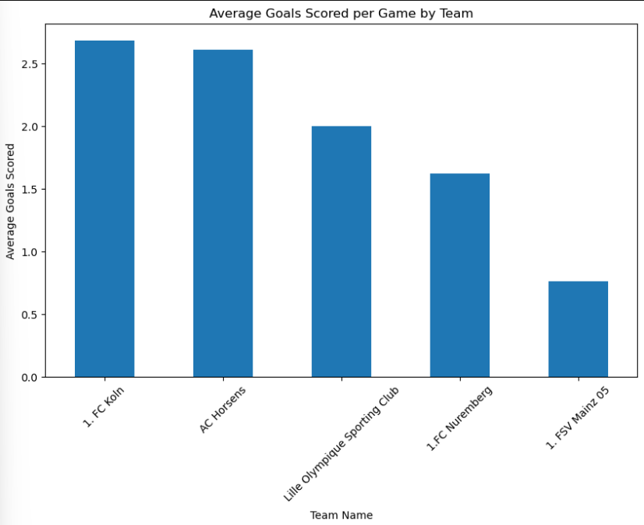
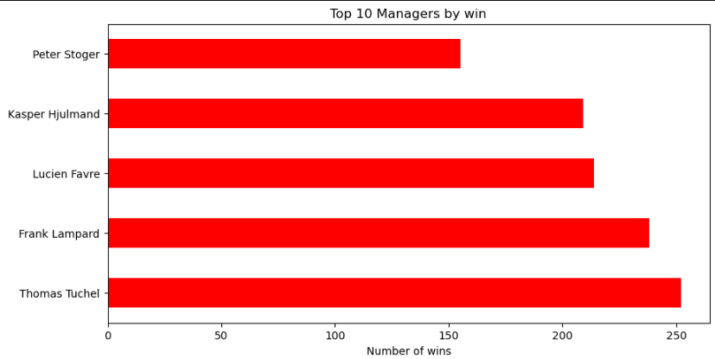
Team Comparsion:
Interpretation:
FC Koln team scored highest number of goals.
Thomas Tuchel is the top manager with highest wins.

Slide 9
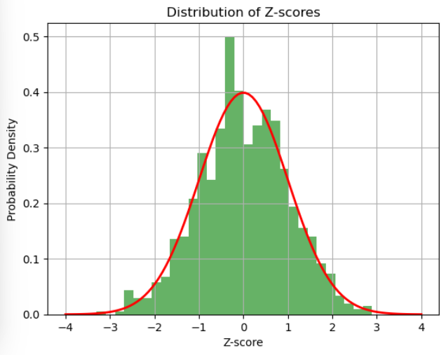
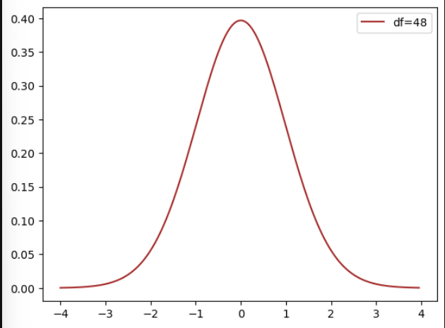
Team comparision:
Interpretation:
1.T-static: This graph represents the probability density function of a t-distribution with 4
8 degrees of freedom (df = 48). The curve closely resembles the normal distribution due to the relatively high degrees of freedom, which indicates that as sample size increases, the t-distribution approaches normality.
This can be used to perform hypothesis testing when the population standard deviation is unknown.
2. Z-static: The distribution of z-scores indicates how far individual data points deviate from the mean in units of standard deviations. The majority of z-scores fall within the range of -1 to 1,
suggesting that a large proportion of the data is within one standard deviation of the mean.

Slide 10
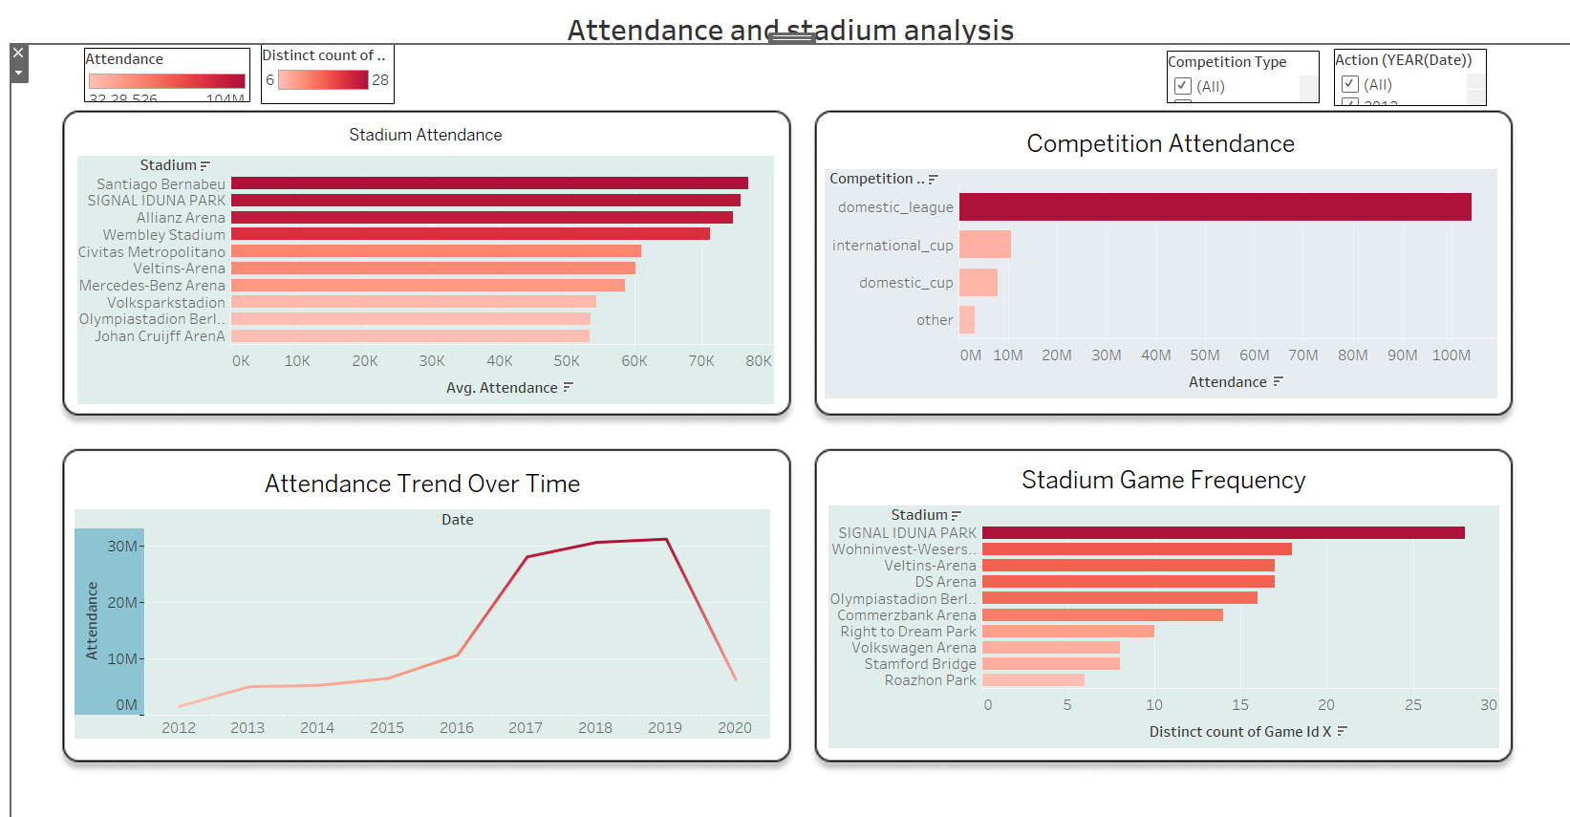
Attendance and stadium analysis:

Slide 11
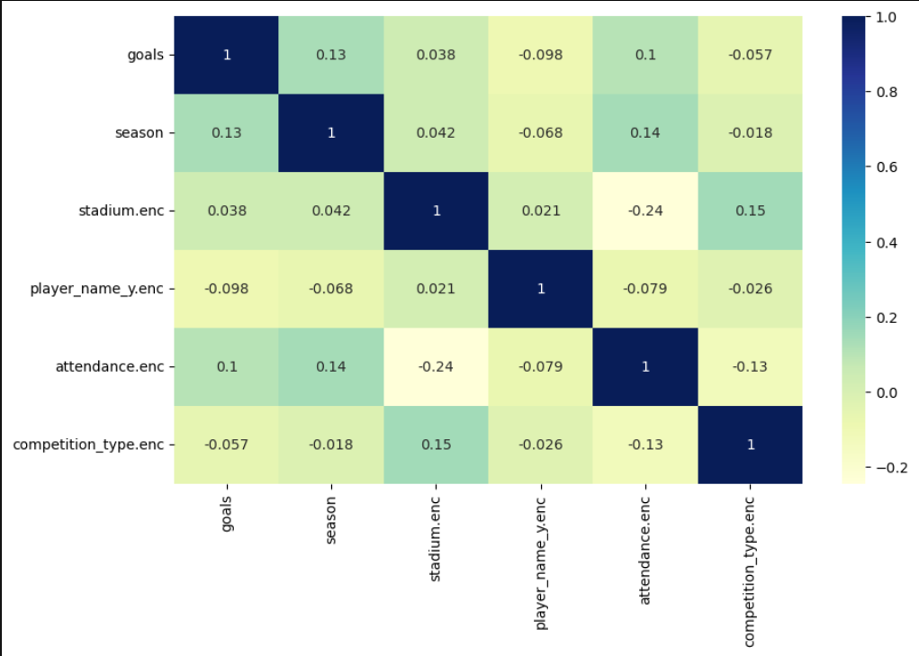
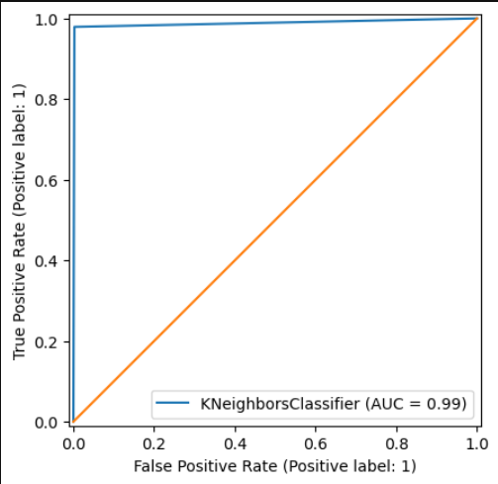
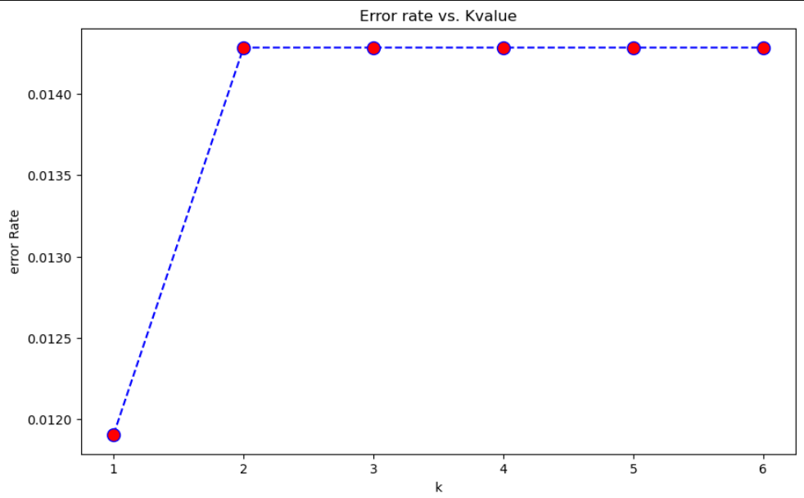
Attendance and stadium analysis:
KNN Classification:
Interpretation:
The ROC curve for the KNN classifier demonstrates exceptional performance with an AUC of 0.99. This indicates that the model has a high ability to distinguish between positive and negative classes. The curve closely hugs the top-left corner of the plot, suggesting that the model achieves a high true positive rate (sensitivity) while maintaining a low false positive rate (specificity). This exceptional performance suggests that the KNN model is highly effective in classifying the data. In essence, the ROC curve visually confirms that the KNN classifier is highly accurate and reliable in predicting the positive class.

Slide 12
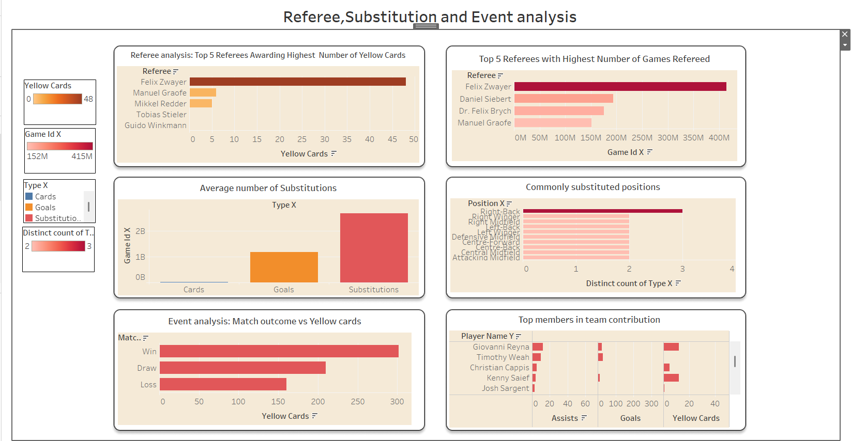
Event, Referee and Substitution:

Slide 13
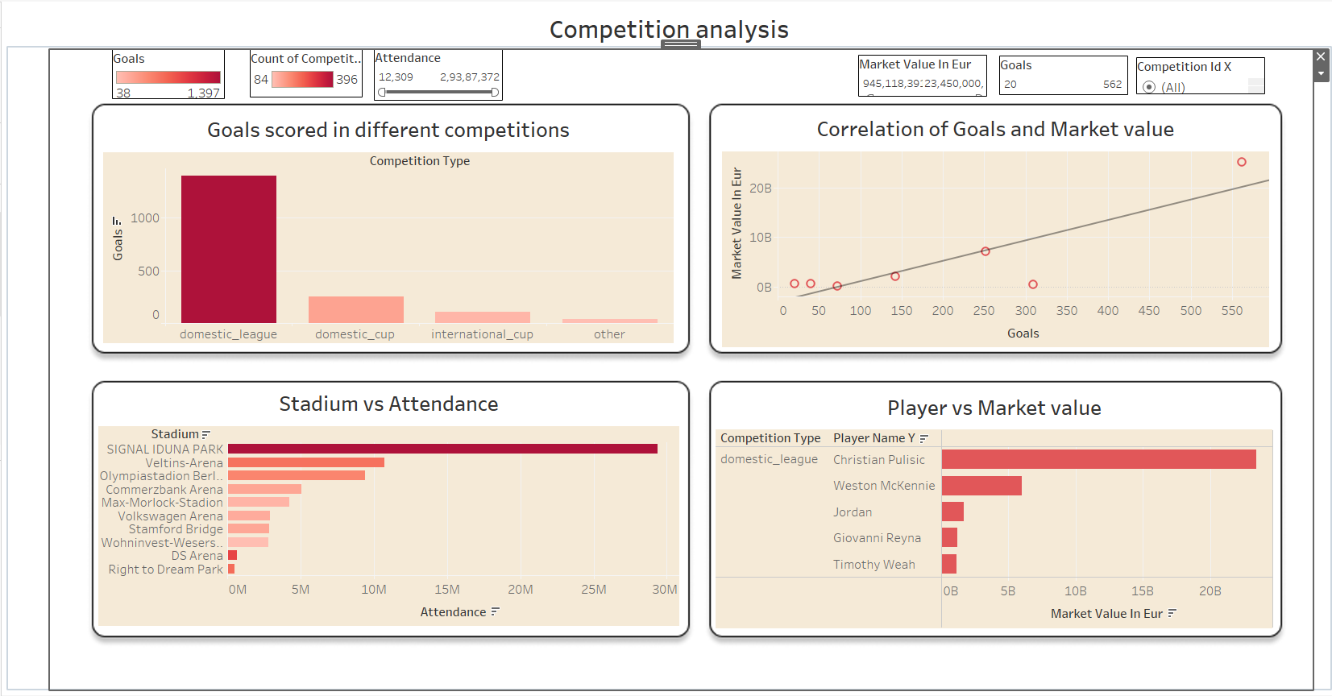
Competition analysis:

Slide 14
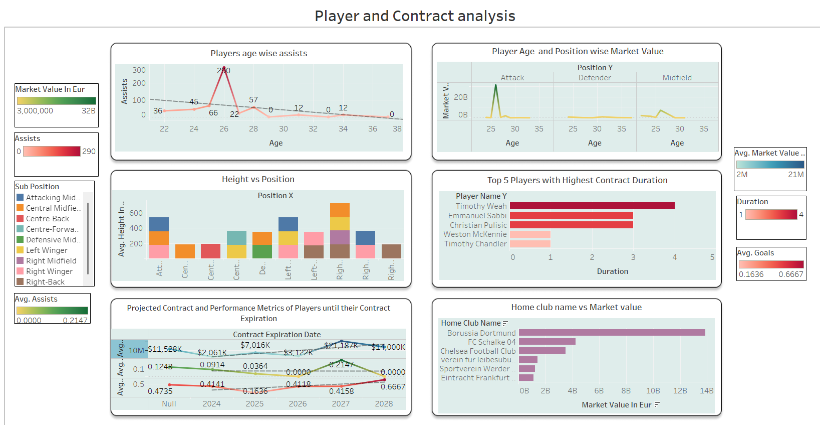
Player Attributes, Demographics and Contract analysis:

Slide 15
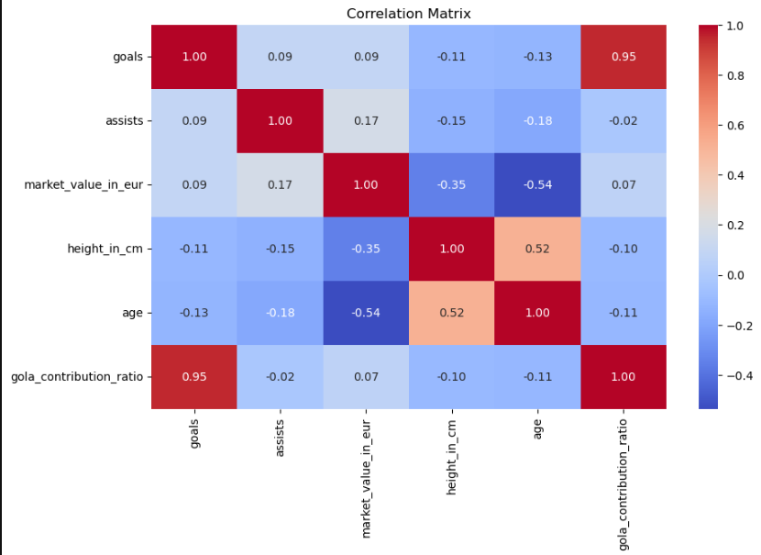
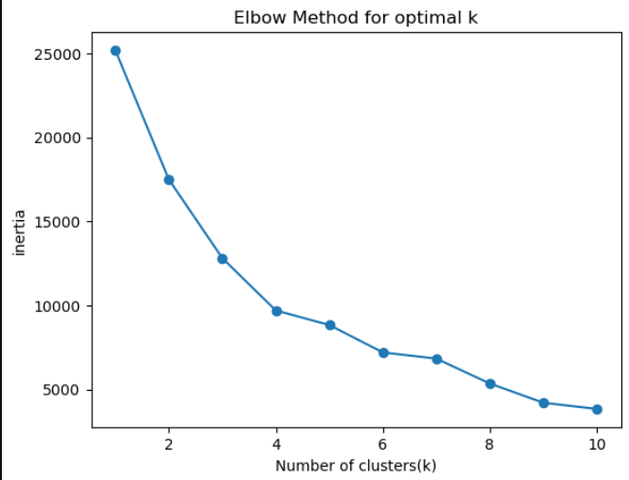
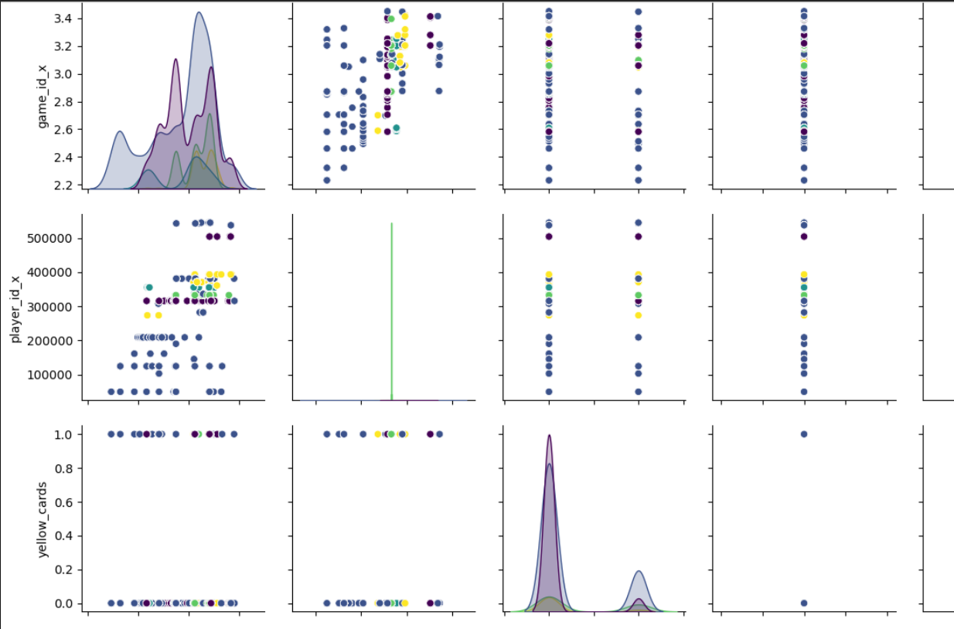
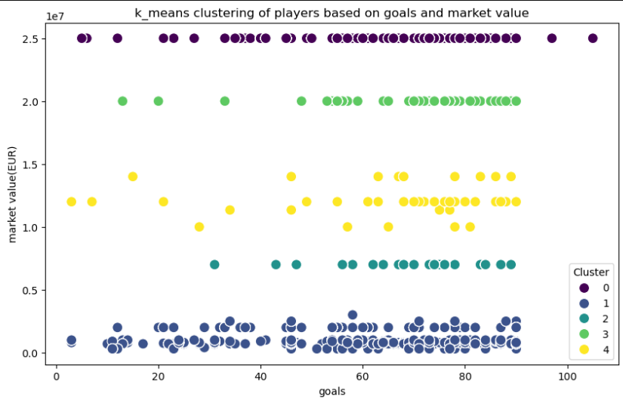
Contract analysis:
K-Means Clustering:
Interpretation:
The correlation matrix reveals moderate positive correlations between goals, assists, market value, and height. The elbow method plot
suggests
an optimal number of clusters around 4-5 for K-means clustering.
The scatter plot visualizing K-means clustering with 4 clusters shows distinct groupings based on goals and market value.

Slide 16
Business Conclusion:
Overall Business Conclusions
Player Performance Insights:
Christian Pulisic excels in goals and assists, indicating his key contribution to his team.
Giovanni Reyna holds the highest market value, making him a pivotal player for team strategy and marketing.
Defensive players with lower encoded positions contribute less to scoring but are crucial for overall team balance.
Team Performance Highlights:
Top-performing home teams: Manchester City, Liverpool, and FC Bayern Munich.
Top-performing away teams: FC Bayern Munich, Koninklijike Racking Club Genk, and Arsenal.
FC Koln scored the highest number of goals overall, showcasing strong offensive gameplay.
Managerial Excellence:
Thomas Tuchel emerges as the manager with the highest wins, demonstrating strategic and leadership superiority.

Slide 17
Improvements:
Player Development:
Focus on training defensive players to improve their contribution to offensive metrics like assists and goals.
Leverage data on player height, market value, and goals correlation to identify potential rising stars.
Team Strategies:
Optimize home-game strategies for teams underperforming at home by analyzing tactics of top-scoring teams.
Improve away-game performance using insights from leading away-scoring clubs like FC Bayern Munich.
Managerial Analytics:
Use win metrics to benchmark managerial performance and provide targeted resources to underperforming managers.
Share successful strategies of top managers like Thomas Tuchel with other team managements.

Slide 18
Revenue Optimization:
Player Market Value:
Capitalize on players with high market value (e.g., Giovanni Reyna) through merchandise, endorsements, and fan engagement campaigns.
Monitor player performance to make informed decisions about transfers and renewals.
Team Branding & Fan Engagement:
Promote top-performing teams and players through social media campaigns to boost ticket sales and brand sponsorships.
Host events highlighting high-performing clubs and players to increase attendance and engagement.
Data-Driven Sponsorship Deals:
Use insights from correlations (e.g., goals, assists, market value) to create compelling pitches for sponsorships.
Position high-performing managers and players as brand ambassadors for targeted marketing campaigns.

Slide 19
THANK YOU

